Slide 1
Department of Management Studies
E-commerce (Open Course )

Slide 2
Objective of the Course
Department of Management studies (BBA) is offering E-commerce as Open Course for the UG students of various course offered under the Calicut University.
The objectives of the course(e-commerce) are:
  To understand the importance of database systems for business management.
  To gain a practical orientation to database development and maintenance.

Slide 3
E-commerce
E-commerce, also known as electronic commerce or internet commerce, refers to the buying and selling of goods or services using the internet, and the transfer of money and data to execute these transactions. Ecommerce is often used to refer to the sale of physical products online, but it can also describe any kind of commercial transaction that is facilitated through the internet.

Slide 4
Syllabus Offered
Module 1
  Introduction to E- commerce
  E- Commerce – Impacts, Challenges & Limitations
  Supply chain management
  E – Commerce infrastructure
Module 2
  Business models of e-commerce
  E-commerce strategy
  Influencing factors of successful e-commerce

Slide 5
Syllabus Offered
  Module-3
    Electronic Payment System
      Online payment systems – prepaid and postpaid
      payment systems (e- cash, e- cheque, Smart Card, Credit Card , Debit Card, Electronic purse )
      Security issues on electronic payment system, solutions to security issues, biometrics (types of biometrics)
    Legal and ethical issues in E- Commerce

Slide 6
References
Turban, Efraim, David King et. el.: Electronic Commerce: A Managerial Perspective, Pearson Education Asia, Delhi 2002.
Kalakota, Ravi: Frontiers of Electronic Commerce, Addison - Wesley, Delhi 1999.
Rayport, Jeffrey F and Jaworksi, Bernard J: Introduction to E-Commerce, Tata McGraw Hill, New Delhi 2003.
Smantha Shurety,: E-Business with Net Commerce, Addison - Wesley, Singapore 2001.
Rich, Jason R: Starting an E-Commerce Business, IDG Books, Delhi 2000.

Slide 7
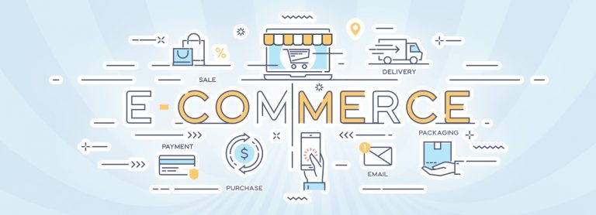
Thank You !!

